Slide 1


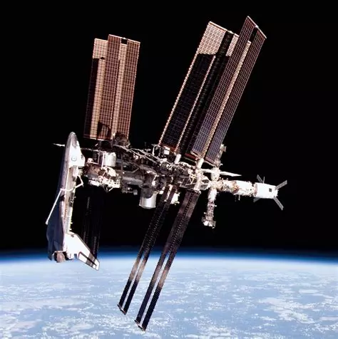
Not A Scrap
(Probably written with a custom font to make it look cooler)
Play
Logbook
Change save
(These should highlight when you hover over it with your mouse)
Options
Credits
Quit
(But desertic/apocalyptic)

Slide 2
Credits
Léo Pages Eliott Passama
Programmation
Game design
Testing
Art
Auxiliary apps
Programmation
Game design
Music and sound design
Writing
Return to menu

Slide 3
Not A Scrap
Choose a save file
(Probably written with a custom font to make it look cooler)
Save 1
placeholder
Characters unlocked : x/9
Items unlocked : x/?
Environments discovered : x/9
Weapons found : x/16
Enemies encountered : x/23
Bosses defeated : x/6
Interactables found : x/29
Completion : x%
Longest run : x bunkers
Deadliest run : x kills
Most bountiful run : x items
Favorite character : x
Favorite item : x
Favorite interactable : x
Most killed enemy : x
Least used character : x
Least used item : x
Least used interactable : x
Most died to enemy : x
Save 2
placeholder
Characters unlocked : x/9
Items unlocked : x/?
Environments discovered : x/9
Weapons found : x/16
Enemies encountered : x/23
Bosses defeated : x/6
Interactables found : x/29
Completion : x%
Longest run : x bunkers
Deadliest run : x kills
Most bountiful run : x items
Favorite character : x
Favorite item : x
Favorite interactable : x
Most killed enemy : x
Least used character : x
Least used item : x
Least used interactable : x
Most died to enemy : x
Save 3
Empty
Click to create a new save file
Play
Logbook
Change save
(These should highlight when you hover over it with your mouse)
Options
Credits
Quit
(But desertic/apocalyptic)

Slide 4
Not A Scrap
(Probably written with a custom font to make it look cooler)
Give a name to save 3
Play
Confirm
Cancel
Logbook
Change save
(These should highlight when you hover over it with your mouse)
Options
Credits
Quit
(But desertic/apocalyptic)

Slide 5
Options
Control scheme :
Music volume :
Sound effect volume :
Any other option we eventualy de- cide to add
ZQSD / WASD / ↑←↓→
100%
100%
Return to menu

Slide 6
(We'll add the actual content of the logbook once we've made the items, weapons and enemies)
Characters
Items
Enemies
Interactables
Environments
Achievements
Return to menu

